Slide 1

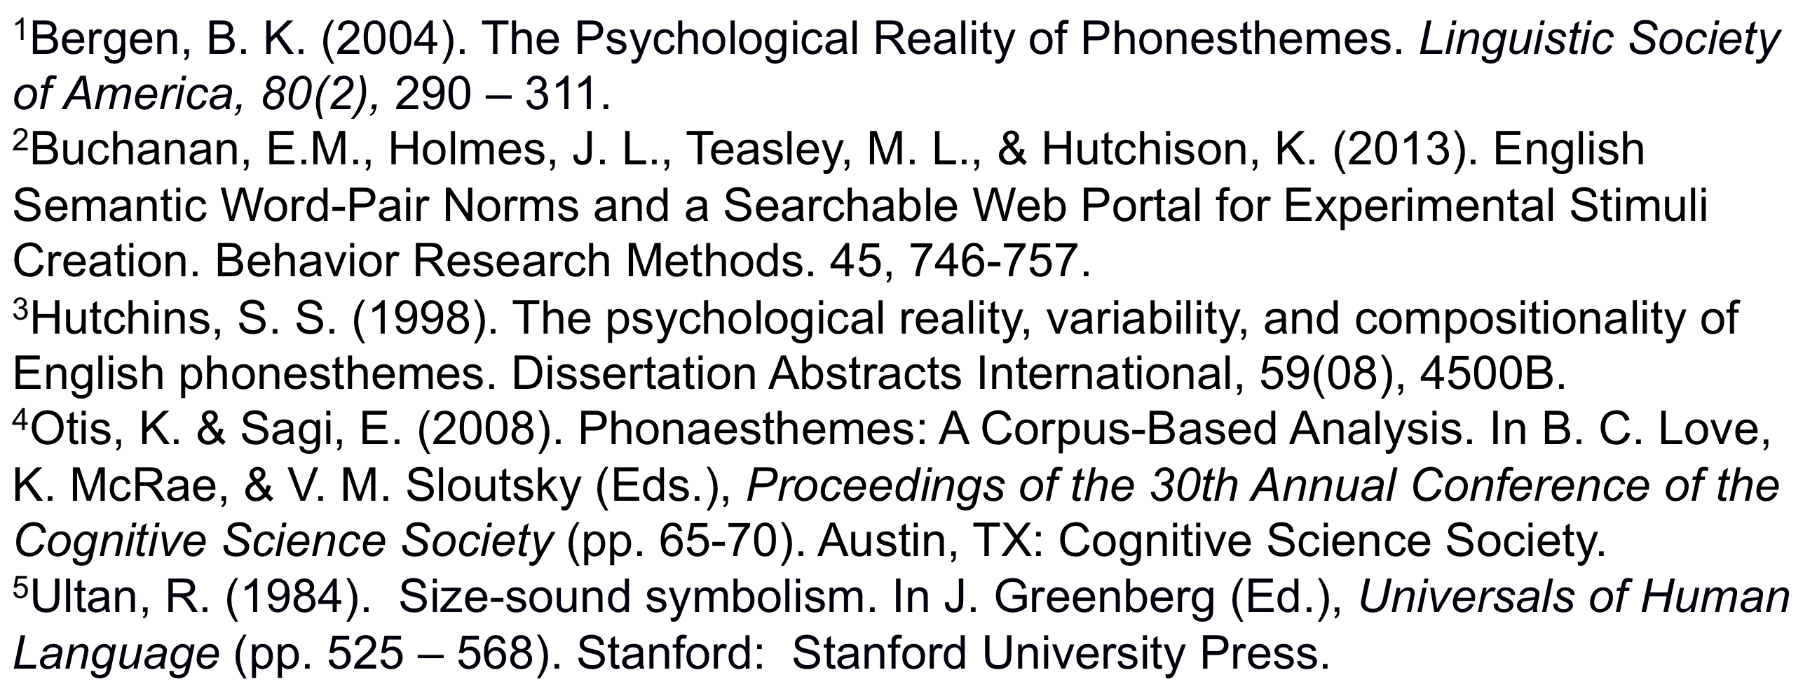
Phonetic Symbolism in an Associative Definition Task
Jahnavi R. Delmonico, Erin M. Buchanan, Ph.D., Samantha G. L. Hunter
Department of Psychology
Missouri State University, Springfield, MO
INTRODUCTION
RESULTS
Philosophers and researchers have debated the existence of innate sound/meaning relationships for centuries.
Phonesthemes, or units of sound associated with particular concepts regardless of linguistic context, represent one form that this connection may take. The psychological reality of phonesthemes has been studied using matching (Hutchins, 1998) and priming (Bergen, 2004) paradigms, both of which limit the range of responses available to participants.
In this experiment, we sought to remove this obstacle by looking for phonesthemes in a large dataset collected using semantic feature production methods, thereby eliminating any hint of suggestion.
We chose phonesthemes that demonstrated strong effects in Otis and Sagi’s (2008) corpus-based assessment, and examined their natural occurrence in participants’ responses to their semantic glosses.
Hypothesis 1.
Sound clusters were coded for both synonyms and antonyms if they included the target phonesthemes.
We expected to find a large match value for synonyms, a small match value for antonyms.
We used Chi-square to compare the number of matches for synonyms to the number of matches for antonyms, which was non-significant for light, vision, and liquid words.
Hypothesis 3.
The beta value between match presence and cue type (synonym/antonym) was also calculated, while controlling for frequency of cue-feature pair.
We expected to find a positive relationship between match and cue type, after controlling for semantic frequency.
Only vision approached significance, p = .09. All other p values were non-significant.
Light, X²(1) = .08, p = .78
 | Match | Mismatch
Antonym | 14 | 1780
Synonym | 14 | 2127
Liquid, X²(1) = .09, p = .77
Antonym | 17 | 853
Synonym | 36 | 1582
Vision, X²(1) = 1.87, p = .17
Antonym | 0 | 155
Synonym | 12 | 616
 | Cue-Target Frequency | Cue Type
Light | -.009 | -.02
Liquid | .008 | .01
Vision | .06 | .002
METHODS AND PARTICIPANTS
CONCLUSIONS AND FUTURE DIRECTIONS
The data were collected as part of a larger semantic feature production project (Buchanan et al., 2013). Participants were given cue words (clear, sight, dry) and asked to define the cue word by listing target features (transparent, see, arid).
The list of cue words provided to participants was searched for cues that have been described in previous phonetic symbolism research as semantic glosses (light, vision, liquid) for our chosen phonesthemes.
A thesaurus was used to determine both synonyms and antonyms of these cue words, which were also included if they appeared on the cue list.
We coded the features given by participants in response to these cues for whether/how often the feature contained the phonestheme.
The paradigm used in this study may be the first to investigate the natural occurrence of phonestheme-containing words in response to a semantic gloss, as opposed to the reverse (i.e. given a non-word containing a phonestheme, what definition does one invent).
This paradigm has the potential to better address the usage and prominence of phonesthetic words in non-restrictive language-generation tasks.
In our study of semantic normed data, no relation between cue-feature sound symbolism appeared. These effects may interact with other unstudied variables, such as letter/phoneme cluster frequency or overall word frequency.
Further research may indicate if the sound associations previously studied are found more in contextual usage, rather than definitional, as studied here.
Hypothesis 2.
For back/front vowels (as defined in the International Phonetic Alphabet), we recorded how many of each type of vowel the feature word contained.
Match values indicated the number of matching sounds were in the listed feature (i.e. small-small, large-large), while mismatch sounds were the number of mixed sounds (i.e. small-large, large-small).
Two 2 (cue type) X 2 (match type) mixed factorial ANCOVAs were analyzed on number of sounds, using cue-target frequency as a covariate.
We expected to find a significant interaction, where synonyms had higher match than mismatch values, and antonyms higher mismatch than match values.
This hypothesis was not support for small words, F(1, 5101) = 0.61, p = .43, or large words, F(1, 5066) = 0.12, p = .73.
Interestingly, antonyms showed more match and mismatch values than synonyms for small words (ps = .003, .005), and correspondingly the reverse was true for large words (ps = .02, < .001).
ANALYSES AND STUDY QUESTIONS
REFERENCES
Hutchins (1996), Otis & Sagi (2008), and Ultan (1978) identified the following consonant clusters as phonesthemes for the following semantic glosses:
Cluster/Sound | Semantic Gloss | Common Examples | Cue Synonym Examples | Cue Antonym Examples
"GL" | Light/Vision | glitter, glow, glare, glisten | sun, clear, vivid | dark, cloudy, difficult
"DR" | Liquid | drip, drain, drizzle | dissolve, fluid, juice | dry, hard, freeze
Front vowels | Smallness | tiny, itty-bitty, petite | narrow, short, little | large, great, fat
Back vowels | Largeness | huge, colossal, enormous | full, grand, broad | minor, narrow, short
Questions? Contact: Jahnavi Delmonico (jahnavidelmonico@gmail.com) or Erin Buchanan (erinbuchanan@missouristate.edu)

